Slide 1
Accreditation Webinar Part 2
Meeting the Standards

Slide 2
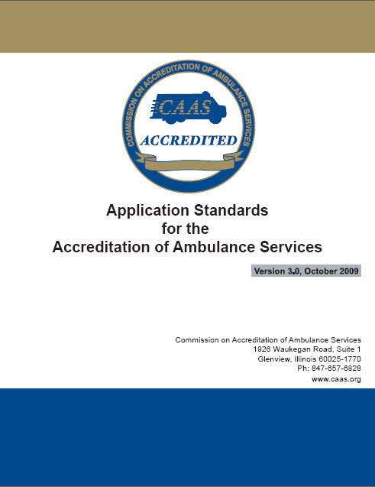
Meeting the Standards
The CAAS Standards
Attributes essential to modern EMS organizations
developed by consensus of EMS peer professionals
Comprehensive standards
Ten key areas

Slide 3
Standards and Characteristics
Each key section is comprised of:
Purpose
Standards
One or more characteristics describe each standard
Each characteristic will contain minimum requirements

Slide 4
The CAAS Application
Directly tied to standards
Provides clear instructions
Template for self-assessment /document review
Documentation checklist to guide you

Slide 5
101 – Organization
Disclosure of ownership
Type of structure with documentation
Organizational chart
Job descriptions
Relationships to Medical Control and regulatory agencies

Slide 6
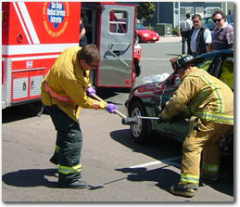
102 – Inter-Agency Relations
Mutual Aid
Disaster Coordination
Conflict Resolution
Inter-Agency Dialogue

Slide 7
102 – Inter-Agency Relations
Document the process and maintain relationships
Mutual aid agreements must address:
  Issues of liability
  Fees charged for services
  Communications capabilities
  Reciprocity and mutuality of assistance offered

Slide 8
102 – Inter-Agency Relations
Active role in regional disaster response plans
Evidence of formal plan addressing:
  Incident command
  Role of EMS agency
  Triage and transport
  Logistics and staging
  Other external resources
  EOC

Slide 9
102 – Inter-Agency Relations
Documentation of participation in disaster simulations
  Minimum of one per year
  Actual disasters cannot replace simulation events
Must be properly critiqued and documented

Slide 10
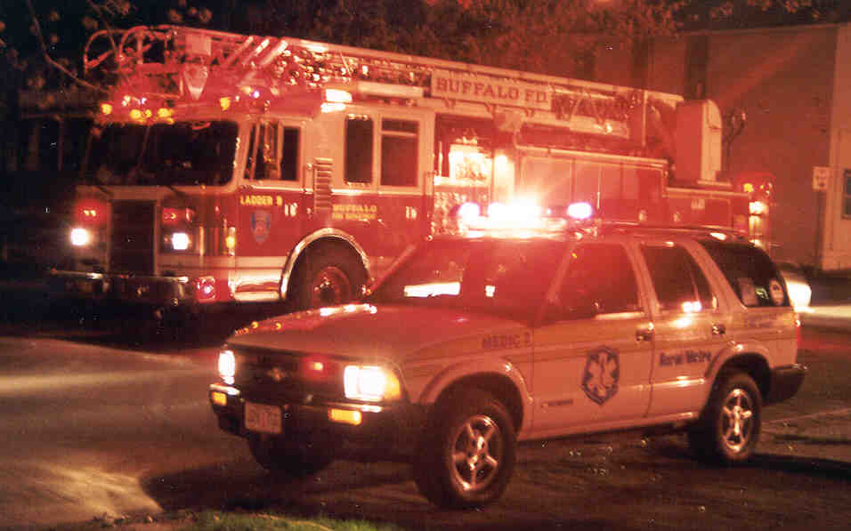
102 – Inter-Agency Relations
Inter-Agency Dialogue
Other EMS agencies
Hospital personnel
Public safety agencies
Government officials

Slide 11

102 – Inter-Agency Relations
Conflict resolution policy must address:
  Reporting
  Investigation process
  Resolution
  Feedback
  How incidents are tracked and trended
  How incidents create change

Slide 12

103 – Management
Formal policies and procedures in place
  Written
  Organized
  Accessible
  Properly reviewed

Slide 13
103 – Management
Strategic Planning
  Short, midrange and long term
  Connected to budgeting process
Management Development
  Current and future leadership development
  Initial and ongoing training

Slide 14
103- Management
Information Management
  Records maintenance
  Electronic data back-up
  Back-up power requirements

Slide 15
104 – Financial Management
Clear lines of authority and accountability
Delegation of financial responsibility
Annual budget
Adequate financial controls
Annual external review of financial records
Business planning and strategic plan tied to the budget
Documented accounting system using GAAP

Slide 16
104 – Financial Management
Billing and Collection policies consistent with federal and state consumer protection laws
  Customer service
  Collections
  Exceptions/write-offs
  Complaints
  Insurance denials

Slide 17

104 – Financial Management
Comprehensive training for billing personnel
  Initial
  Ongoing
Compliance program
Documentation of insurance
  Liability (General, Vehicle)
  Workers Comp
  Malpractice
  Directors/Officers

Slide 18
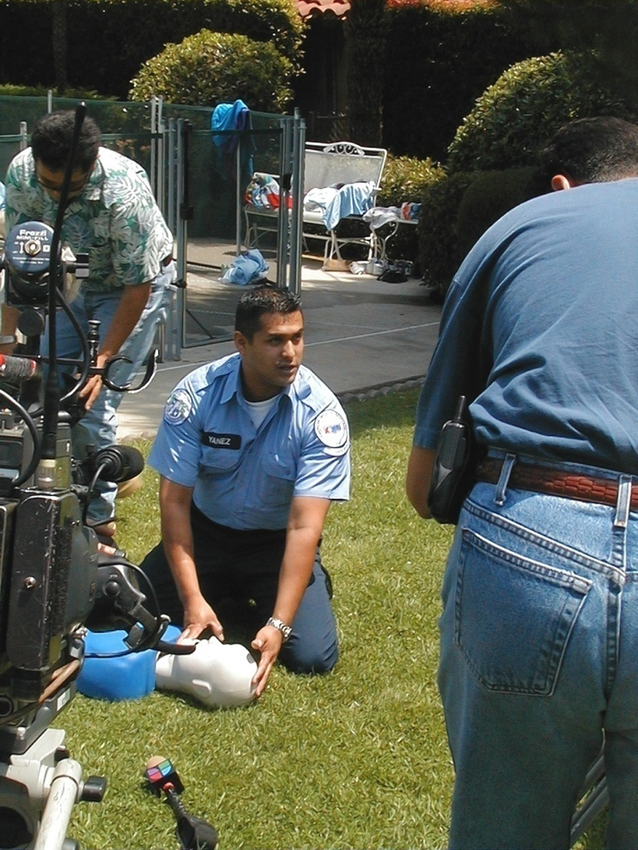
105 – Community Relations and Public Information
EMS Has a responsibility to educate
and inform the public:
Ethical advertising
  Print and electronic
Promote pre-hospital care
Injury prevention and health promotion
Community service activities(other than providing ambulance services)

Slide 19
105 – Community Relations and Public Information
Community education initiatives
  Must be documented
    Type of education provided
    Dates and times
    Program description and goals
    Estimated number of participants
  Summary reports
  Participant feedback

Slide 20
105 – Community Relations and Public Information
Specialty care transport (SCT) education initiatives
  Must be provided to transferring and receiving facilities
    SCT standards
    Capabilities and limitations
    Procedures and guidelines
    Patient benefits
    Appropriateness
  Summary reports
  Participant feedback

Slide 21
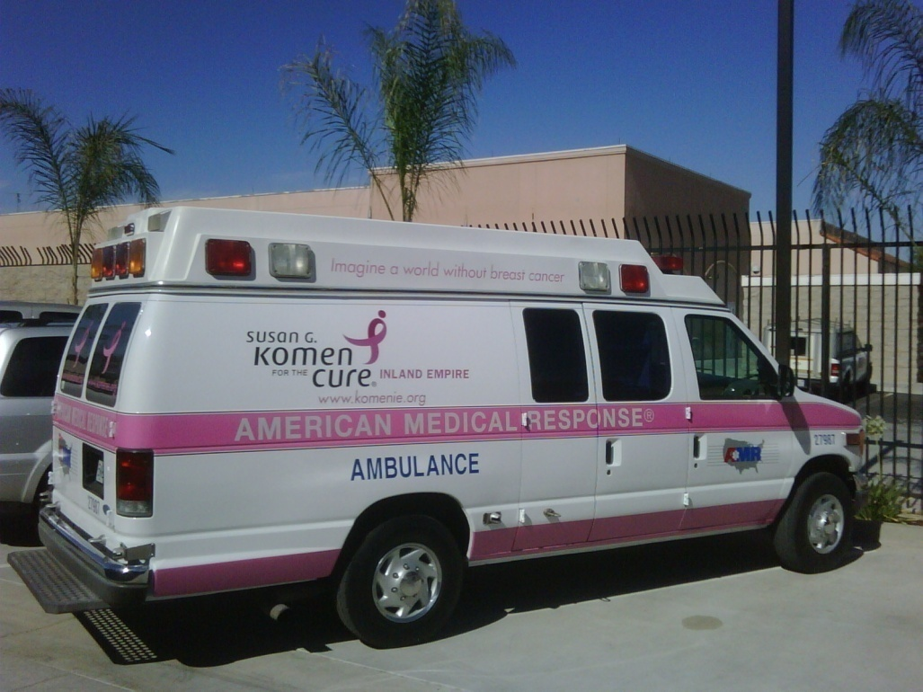
105 – Community Relations and Public Information
Donation policy
  Monetary
  In kind
  Must be documented
Media relations policy
  Requests for information
  Generating coverage
  Tracking media coverage

Slide 22

105 – Community Relations and Public Information
Community Diversity
  Assess
  Address
  Educate

Slide 23

105 – Community Relations and Public Information
Policy for Handling Complaints
  Reporting and documenting
  Investigation process
  Resolution
  Feedback
  Track and trend
  How information is used to improve service
    Individual
    Organization

Slide 24
105 – Community Relations and Public Information
Customer Feedback Programs
  Solicit feedback from customers
    Who are your customers?
  Methods used
  Must be documented and shared
  How information is used to improve service
    Individual
    Organization

Slide 25
106 – Human Resources
Maintain employee credentials
  EMS Licensure/Certifications
  Motor vehicle licensure
  Driving record
  Management and job specific training
Compensation package
  Pay, Benefits, PTO/ET
  Description of time/duties
Recruitment & Hiring
  Job postings
  qualifications
  Medical Director involvement in selection process
  EEOC
  Affirmative Action/Diversity Plan

Slide 26
106 – Human Resources
Employee Training & Development
  Orientation training
  Ongoing training
  Job specific training
  Continuing medical education (CME’s)
  Medical Director involvement
  Tied into performance improvement program

Slide 27

106 – Human Resources
Problem Resolution
  Reporting
  Investigation
  Resolution
  Feedback
Discipline/Corrective Action
  Examples of unacceptable actions
  Disciplinary authority
  Grievance process
  Progressive discipline
  Termination

Slide 28
106 – Human Resources
Standards for Professional Conduct
  Confidentiality
  Customer service philosophy
  Non-discrimination
  Standards for dress and hygiene
Performance Evaluations
  Annually
  All employees
  Based on job description
  Feedback mechanisms
  Employee involvement and signature
  Access to prior reviews

Slide 29

If Your Work Force Is Unionized:
Do you have to get their approval for implementation of new policies?
Make sure your policies are compatible with existing labor agreements
Communicate with union leadership and involve them in the accreditation process

Slide 30
201 – Clinical Standards
Medical Oversight
  17 Areas of MD involvement
  Dispatch
  Patient care & transport protocols
  Training & education
  Performance improvement
  System design
Clinical Protocols
  Scope of practice for each level of service
Protocol Review
  Based on medical evidence
  Local practice standards
  Emerging technologies

Slide 31
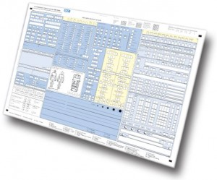
201 – Clinical Standards
Patient Care Records
  Required data and documentation
  Distribution to receiving facility
Staffing Standards
  Each level of service
Response Plan
  Triaging requests
  Response time standards
    Reporting
    Monitoring exceptions
    Track and trend
    Operational changes

Slide 32
201 – Clinical Standards
Clinical standards performance improvement program:
Medical Director oversight
Prospective/Concurrent/Retrospective initiatives
Established indicators and thresholds
Identify and address exceptions
Reporting of PI findings
  Individual and system performance
  Based on defined clinical indicators
  Annual assessment of entire PI/CQI program
Directly connected to training/ongoing education

Slide 33
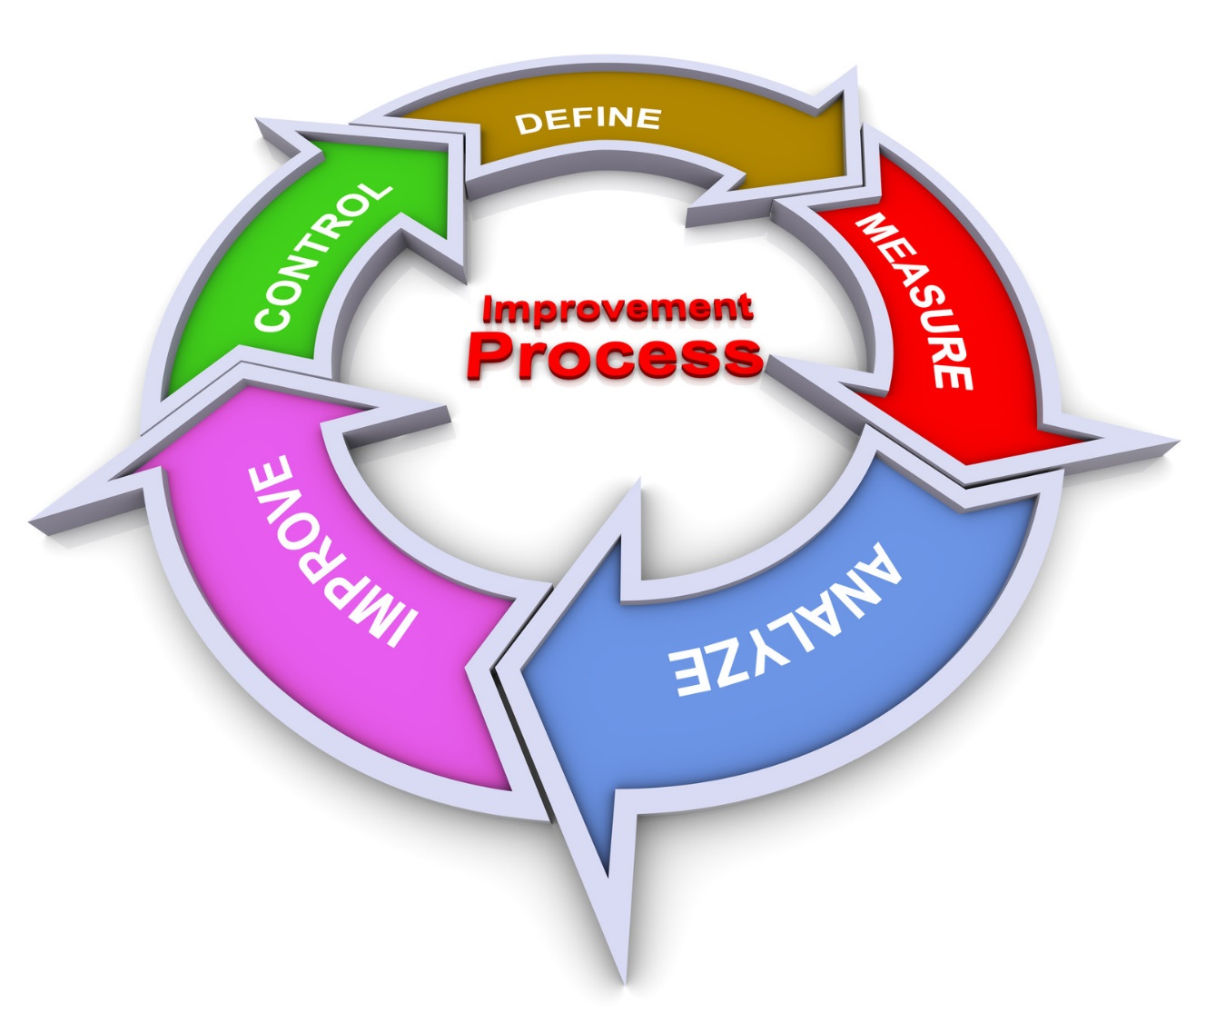
Performance Improvement Never Stops…

Slide 34
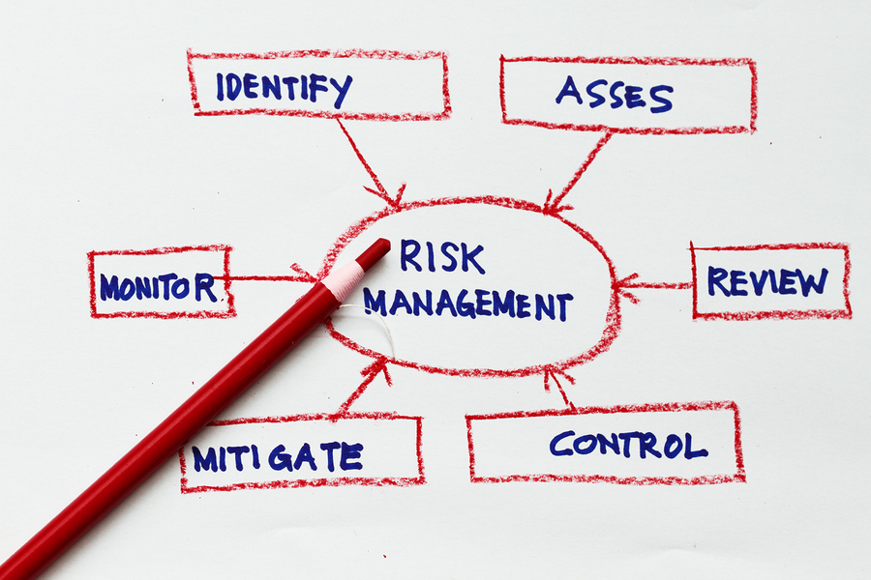
202 – Safe Operations &
Managing Risk
Driver Training
Vehicle Safety
Employee Safety
Patient Safety
Safety Restraints
Patient Personal Property
Incident Reporting
Critical Failures
Medical Errors
Loss Control

Slide 35

203 – Equipment & Facilities
Vehicles
Vehicle maintenance
Medical equipment maintenance
Replacement schedules
Disposable items
Facilities
Facility Labeling for Walk-Ins

Slide 36
203 – Equipment & Facilities
Locking of ambulances, ALS supplies and medications
  At all times while unattended (yes, this includes ON CALLS)
  Use of tamper-evident systems
Medication temperature extremes
  Know your limits
  Have a mechanism and process
  What happens “if” something is exposed?

Slide 37

204 – Communications Center
Policies and Procedures
Contingency Plans
Preventive Maintenance
Training
Licensure
Communications
Communications Performance Improvement Program
Medical Director Involvement
Portable Communication Capabilities
Equipment Replacement Schedule
Communications Training
Inter-Agency Dialogue

Slide 38
…But What if We Outsource?
If you choose to outsource some part of your business:
  Must fully meet all requirements of CAAS standards
  Must provide you with ongoing evidence of compliance
If you are mandated to outsource some part of your business:
  Clear and detailed documentation required
  Continuous, ongoing efforts to request compliance must be documented and presented to CAAS
  Panel to deliberate based upon documentation

Slide 39

Thinking Outside the Box
Draw this simple box of dots on a piece of paper
The idea is to connect all the dots using no more than 4 straight lines
Position your pencil on one of the dots and do not allow the pencil to come off the paper, that is, do not pick up the pencil and start from another place in the box. It must be a continuous flow of writing once you start. Think outside the Box!

Slide 40

Thinking Outside the Box

Slide 41


Thinking Outside the Box

Slide 42





Do You Need Help?
Consultants
Accredited Peers
CAAS Staff
CAAS Helpline
Ask CAAS
On Demand
Website
Social Media

Slide 43

Questions?

